Slide 1
VOLUME 2: SECTION 3
CHAPTER 2:
MANAGING OVER IPC PROGRAM
PROGRAM MANAGEMENT AND GOVERNANCE

Slide 2
Chapter Content
Structure and organization of IPC
Principles of emergency management
Role of health care facility
Information sharing and communication

Slide 3
Learning Objectives
Describe the structure and organization of IPC and PS program management
Identify the roles and responsibilities of HCWs involved in IPC programs
Explain the attributes of effective IPC and PS programs
Mention the core components of IPC/PS programs.
Describe the major IPC Activities
Explain the continuous improvement of IP and PS practices using model for improvement.

Slide 4
Overview
Proper management of infection prevention and Control programs at various levels of implementation has paramount importance for the success and fulfillment of basic strategic objectives for improving health outcomes.
It is also a key component of health system strengthening.
Due to the fact that available resources are invariably limited, careful planning, implementing and monitoring activities on a regular basis are all essential from primary tertiary level in the health care system.

Slide 5
Structure and Organization of IPC programs
Having a robust structure and capacity in IPC at national and local levels
Strengthens the ability to plan and implement all core components of IPC and also respond to communicable disease emergencies.

Slide 6
Structure and Organization of IPC and PS programs cont’d…
The WHO Core Components of IPC are:
IPC programs at national and facility level
IPC guidelines at national and facility level
IPC education and training at national and facility level
Surveillance of HAIs at national and facility level
Multimodal strategies for implementing IPC activities at national and facility level
Monitoring and evaluations and feedback at national and facility level
Workload, staffing, and bed occupancy at the facility level
Built environment, materials, and equipment for IPC at facility level

Slide 7
The three primary goals for facility-level IPC programs are to
Protect patients from health care associated infections and other health related hazard
Protect HCWs, visitors, and others in the health care environment
Achieve this protection in the most cost-effective manner within the constraints of available resource

Slide 8
Some considerations and examples for possible IPC/PS program structure
All responsibilities of the program are carried out by IPC focal staff and are guided by a health care epidemiologist/infectious disease physician or other physicians with relevant expertise
The IPC team is composed of the IPC focal staff/s, chair of the committee

Slide 9
Some considerations and examples for possible IPC/PS program structure cont’d…
An IPC committee is the central decision-making body reporting to the medical staff administration.
Multidisciplinary support is obtained via quality improvement teams that meet regularly and are responsible for planning, policy development, interventions, and decision-making rather than via an IPC team.

Slide 10
Some considerations and examples for possible IPC program structure cont’d…
IPC staffs should have designated hours each week (less than full time) to dedicate to IPC.
If one IPC/PS staff member attends multiple clinics or facilities for IPC activity, a structure like an IPC committee is important for maintaining support and oversight
The IPC focal staff report to the IPC Committee and are overseen by a separate administrative area.

Slide 11
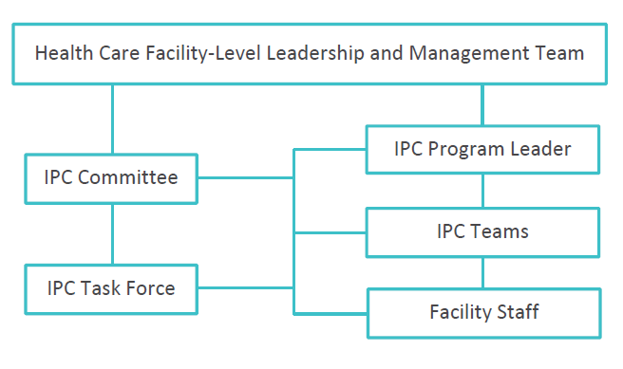
IPC Program Staff Structure at HCF Level

Slide 12
Roles and Responsibilities of Healthcare Workers (HCWs) involved in IPC Programs
Administrative leadership:
The reporting structure for the IPC program varies among health care facilities and can be adapted to fit to the local context of the facility.
One or more health care administrators will supervise the leader of the IPC program and will take an active role in helping to shape and support the program’s priorities and plans.

Slide 13
Roles and Responsibilities of Healthcare Workers (HCWs) involved in IPC Programs cont’d…
IPC/PS committee:
The purpose of the committee is to guide and support the use of recommended practices and to review and resolve related problems that may arise.
Additionally, the committee advocates for resources required for effective implementation of the IPC program.
This committee should include representatives from different wards and units, including procurement, laboratory, sterilization, environmental cleaning…etc.
The IPC committee should meet on a regular basis, usually monthly, to review the available IPC data and any problems or issues that are identified but the IPC team (usually composed of key persons involved in the day-today activity)

Slide 14
Roles and Responsibilities of Healthcare Workers (HCWs) involved in IPC Programs cont’d…
Task forces/working groups:
These may be permanent or temporary groups, and may be created as needed to provide input and oversight for a particular issue.
Task forces/working groups should consist of individuals with multidisciplinary expertise and should be granted authority to make decisions and advise and oversee the IPC leadership and team in addressing the issue.

Slide 15
Roles and Responsibilities of Healthcare Workers (HCWs) involved in IPC Programs cont’d…
Organizational oversight from top facility leadership:
The person or group with organizational authority should periodically review the status of HAIs at the facility and the effectiveness of measures designed to contain them.

Slide 16
Roles and Responsibilities of Healthcare Workers (HCWs) involved in IPC Programs cont’d…
National or regional public health authorities:
Public health authorities work closely with and support the facility-level IPC program, providing expertise, partnership, assistance, guidance documents, support for outbreak investigations, and authority to enforce IPC measures.

Slide 17
Roles and responsibilities of facility level staffs
The organization and structure of a facility’s IPC program, should have a clear concept of the composition, roles, and responsibilities of important program staff, including the IPC committee, program leader, IPC task forces, and facility staff.

Slide 18
Attributes for Effective IPC Programs
A successful IPC program must be able to effectively guide, support, and assess IPC at the facility.
Some of these attributes will be managed by senior facility leadership and some by those designated as responsible and accountable for the facility’s IPC program.

Slide 19
Attributes for Effective IPC Programs cont’d…
An IPC program to succeed, the program must acquire and retain the following attributes:
  Designated staff member/Team who is responsible and accountable for IPC at the facility
  Competent IPC Program leaders with appropriate training and education
  Formal authority granted to the IPC program

Slide 20
Attributes for Effective IPC Programs cont’d…
  Tangible support from facility leadership
  Adequate resources for IPC activities
  Partnerships with key stakeholders and front-line HCWs
  Effective communication about IPC

Slide 21
Major IPC Program Activities
Successful IPC programs are
  Based on understanding the facility’s problems and needs, prioritizing activities, and using available resources effectively.

Slide 22
Major IPC Program Activities cont’d…
The major activities to be e carried out:
  Facility Infection Prevention and Control Risk Assessment
  Program planning,
  Implementation strategies for evidence-based practice
  IPC Program evaluation

Slide 23
Quality Improvement Strategies
Managing processes
Continuous measurement
Collecting data
Engaging the appropriate HCWs

Slide 24
Deming’s PDSA Cycle and Key Elements of Each Step
Act
What changes are to be made on the next cycle
Plan
Objective
Do
Carry out the plan
Study
Complete the Data Analysis
Question and Predictions
Plan to carry out the cycle (Who, What, Where, When)
Document Problem and Unexpected Observation
Begin Data Analysis
Compare Data to Predictions
Summarize What was Learned

Slide 25
Change management
Develop common goal,
Involve stakeholders,
Involve all staff,
Monitor and Demonstrate commitment and consistency

Slide 26
Summary
Strong IPC program is critical for
  Reducing HAI’s
  AMR
  Ensuring patient safety
  Outbreaks response
  Improving quality of care

